Slide 1
Scrum Guide 2020

Slide 2
Scrum
Transparency
Inspection
Adaptation
Values
Product Owner
Developers
Scrum Master
Sprint Planning
Daily Scrum
Sprint Review
Sprint Retrospective
Product Backlog
Product Goal
Sprint Backlog
Sprint Goal
Increment
Definition of Done

Slide 3
Scrum
Definition
Theory
Framework to generate value through adaptive solution of complex problems
Helps to achieve goals and create value
An iterative, incremental approach to optimize predictability and control risk
Based on Empiricism and Lean thinking
Has three pillars to uphold empirical process:
Transparency
Inspection
Adaptation

Slide 4
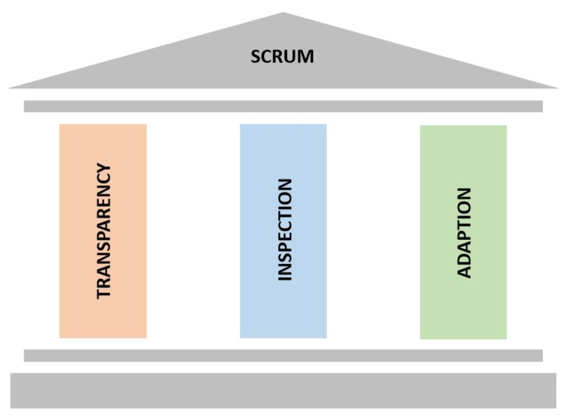
Scrum
Transparency
Theory
Artifacts must be visible to performer and receiver
Low transparency lead to decisions that diminish value and increase risk
Transparency enables inspection
Inspection without transparency is misleading and wasteful

Slide 5
Scrum
Inspection & Adaptation
Theory
Artifacts and progress are inspected to detect variances and problems
Inspection enables adaptation
Inspection without adaptation is considered pointless
Adjustments must be made to minimize further deviations
ST adapts the moment it learns anything new through inspection

Slide 6
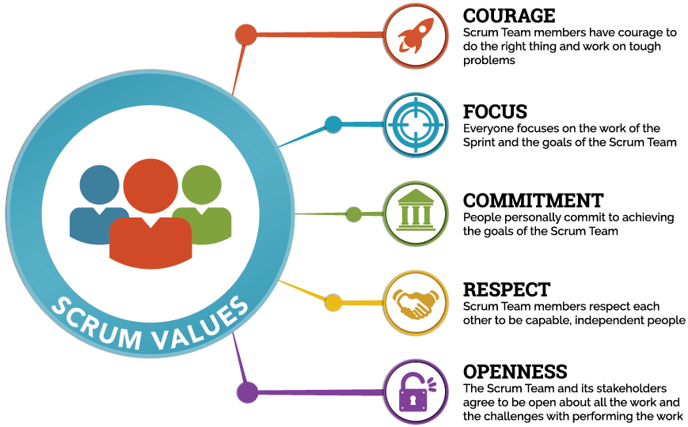
Scrum
Values

Slide 7
Scrum
Developers
Roles
Creates the Increment
Accountable for the following:
Sprint Backlog
Definition of Done
Sprint Goal
They are self-organizing and cross-functional
There are no titles and sub-teams in the Development Team
Should be of 10 or fewer members

Slide 8
Scrum
Product Owner
Roles
Responsible for maximizing the value of the product
Responsible for managing the PB
Developing and explicitly communicating the Product Goal
Creating and clearly communicating PBIs
Ordering PBIs
Ensuring that the PBIs transparent, visible and understood
Has the authority to cancel the Sprint
Notes:
The Product Owner ensures that attendees are prepared to discuss the most important Product Backlog items and how they map to the Product Goal.

Slide 9
Scrum
Scrum Master
Roles
Accountable for ST effectiveness/ success
Is a servant-leader for the ST
Finding techniques for effective Product Backlog management
Ensuring the PB to maximized value
Facilitating Scrum events and Removing impediments
Coaching the Developers in self-organization and cross-functionality
Leading and coaching the organization in its Scrum adoption

Slide 10
Scrum
Sprint
Roles
No changes are made that would endanger the Sprint Goal
Quality does not decrease
The Product Backlog is refined as needed
Scope may be clarified and renegotiated with the PO
Sprint may be considered a short project
A Sprint could be cancelled if the Sprint Goal becomes obsolete

Slide 11
Scrum
Sprint Planning
Events
The work to be performed in the Sprint is planned
Is time-boxed of 8 hours for a 1 month Sprint
Why is this Sprint valuable?
What can be Done this Sprint?
How will the chosen work get done?
Notes:
The Product Owner ensures that attendees are prepared to discuss the most important Product Backlog items and how they map to the Product Goal

Slide 12
Scrum
Daily Scrum
Events
15-minute time-boxed event, held everyday for the Developers
Development Team plans work for the next 24 hours
Helps to inspect progress toward the Sprint Goal

Slide 13
Scrum
Sprint Review
Events
Inspect the outcome of the Sprint and determine future adaptations
ST presents the results of their work to key stakeholders
Progress toward the Product Goal is discussed
Is at most a 4 hour meeting for 1 month Sprints
Provides valuable input to subsequent Sprint Planning
It’s result is a revised Product Backlog that defines the probable items for the next Sprint

Slide 14
Scrum
Sprint Retrospective
Events
Purpose of the Sprint Retrospective is to plan ways to increase quality and effectiveness
Is at most a 3 hour meeting for 1 month Sprints
SM ensures that the meeting is positive and productive
Is a formal opportunity to focus on inspection and adaptation
The purpose of the Sprint Retrospective is to:
Inspect how the last Sprint went with regards to people, relationships, process, and tools
Identify and order the major items that went well and potential improvements
Create a plan for implementing improvements to the way the Scrum Team does its work

Slide 15
Scrum
Product Backlog
Artifacts
An ordered list of what is needed to improve the product
Product Backlog refinement is the act of defining PBIs into precise items
Commitment: Product Goal
Describes a future state of the product which can serve as a target for the ST
The Product Goal is in the PB
PB emerges to define “what” will fulfill the Product Goal
It is an long-term objective for the ST

Slide 16
Scrum
Sprint Backlog
Artifacts
The Sprint Backlog is composed of the following:
Sprint Goal (why),
PBI s selected for the Sprint (what)
Plan for delivering the Increment (how)
Updated throughout the Sprint as more is learned
Commitment: Sprint Goal
Objective for the Sprint
Created during the Sprint Planning

Slide 17
Scrum
Increment
Artifacts
An Increment is a concrete stepping stone toward the Product Goal
Work cannot be considered part of an Increment unless it meets the Definition of Done
Commitment: Definition of Done
When increment meets the quality measures of the required product
When an PBI meets the Definition of Done, an Increment is born
If a PBI does not meet the Definition of Done, it cannot be released

Slide 18
Scrum
Conclusion
Sprint
In a nutshell, Scrum requires a Scrum Master to foster an environment where:
PO orders the work for a complex problem into a PB
ST turns a selection of the work into an Increment of value during a Sprint
ST and its stakeholders inspect the results and adjust for the next Sprint
Repeat

